Slide 1
Merge Sort
Programming – Code Design & Data Structures

Slide 2
Contents
Merge Sort
Implementation
Visualization
Performance

Slide 3
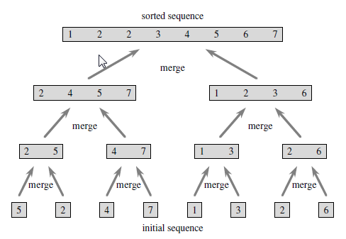
Merge Sort
Merge pairs of 1-item arrays to form a sorted array of length 2
Merge pairs of arrays of length 2 to form a sorted array of length 4
…and so on until
2 arrays of length n/2 are merged to form the final sorted array

Slide 4
Implementation
def Merge (A, p, q, r)
leftEnd = q – p + 1
rightEnd = r – q
create array L[0..leftEnd]
create array R[0..leftEnd]
for i = 0 to leftEnd
L[i] = A[p + i]
for j = 0 to rightEnd
R[j] = A[q + j + 1]
i = 0
j = 0
for k = p to r
if (j >= rightEnd) or (i < leftEnd and L[i] ≤ R[j]) then
A[k] = L[i]
i = i + 1
else
A[k] = R[j]
j = j + 1
def MergeSort(A, p, r)
if p < r
then q = (p+r)/2
MergeSort(A, p, q)
MergeSort(A, q+1, r)
Merge(A, p, q, r)
The key operation is the merging of two sorted sequences
A is an array, p, q, and r are indices numbering elements such that p ≤ q < r
Merge assumes subarrays A[p..q] and A[q+1..r] are in sorted order
Subarrays merged to form current sub array A[p..r]
When merging, right array has no more values when j >= rightEnd
Similarly, left array is empty when i >= leftEnd
Notes:
The key operation of the merge sort algorithm is the merging of two sorted sequences (presented here in the pseudocode for the Merge function)
In the Merge function, A is an array and p, q, and r are indices numbering elements of the array such that p <= q < r.
Merge assumes that the two sub-arrays A[p..q] and A[q+1..r] are in sorted order.
It merges them to form a single sorted sub-array that replaces the current sub array A[p..r]
If we take our playing card example again:
Suppose we have two piles of cards face up on a table. Each pile is sorted with the smallest cards on top.
We wish to merge the two piles into a single sorted output pile.
Our basic step consists of choosing the smaller of the two cards on top of the face-up piles, removing it from its pile, and placing this card onto the output pile.
We repeat this step until one input pile is empty, at which time we just take the remaining input pile and place it on the output pile.
The pseudocode for the Merge function here implements this basic idea. However we have a slight twist. We’ve made the last element in the array ‘empty’ so as to signify the end of the array (this could be implemented in practice in a number of ways).
When the array index specifies an empty element, we add the rest of the elements in the other array to the output array.
Both array indices will never point to empty elements since we know in advance that exactly r-p+1 elements will be placed in our output array, and we can stop once we have performed that many steps.
We use the Merge function as a subroutine in the merge sort algorithm.
The function MergeSort(A, p, r) sorts the elements in the sub-array A[p..r]
If p >= r, then the sub-array has at most one element and is therefore already sorted.
Otherwise divide the array into two sub-arrays and pass those arrays as input into the MergeSort function (that is, call MergeSort recursively)

Slide 5
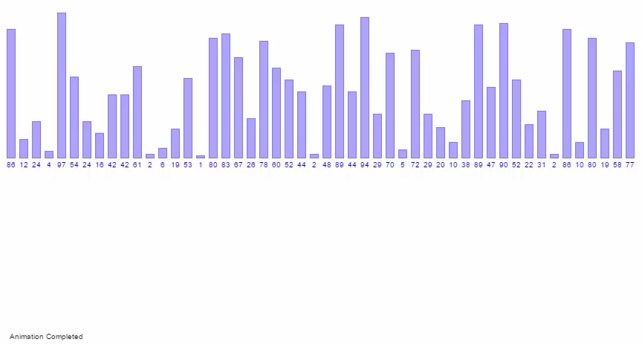
Visualization

Slide 6
Performance
Guaranteed to be O(n log n)
Because it always splits the work in half
Better running time than Insertion Sort
Typically only slightly below that of Quick Sort
Requires additional scratch space proportional to the size of the input array
This might make it unfavorable in situations where memory is an issue (e.g., embedded systems)
When implemented using linked lists, no temporary arrays are needed

Slide 7
Summary
Merge sort is a fast, stable sorting algorithm
It has guaranteed O(n log(n)) efficiency
When sorting arrays it requires additional scratch space for temporary arrays
This isn’t needed with a linked-list implementation
Relatively simple to code, and offers good performance

Slide 8
References
Cormen, T, 2009, Introduction to Algorithms, 3rd Edition, MIT Press
Cprogramming.com. 2017. Merge Sort. [ONLINE] Available at: http://www.cprogramming.com/tutorial/computersciencetheory/mergesort.html. [Accessed 27 April 2017].

